Slide 1
Belonging through assessment: Pipelines of compassion
QAA Collaborative Enhancement Project 2021
Vikki Hill Educational Developer: Attainment Academic Enhancement Team University of the Arts London Launch Event 10 June 2021
Notes:
Hello all.... Super excited to share with you the conversations we’ve been having in developing our project. Discursive, collaborative session Joined by members of the project team – not everyone could make to day . Also my colleague Hannah Hyde who will co-facilaiintg the session with us and running the Q&A. Housekeeping Blackboard

Slide 2
Glasgow School of Art
Allan Atlee Deputy Director Academic,
Professor Vicky Gunn Head of Teaching and Learning
University of the Arts London
Vikki Hill (Project Lead) Educational Developer: Attainment
Liz Bunting Educational Developer: Academic Enhancement
Dr Emily Salines Educational Developer: Academic Enhancement
Carole Morrison Educational Developer LCF Academic Enhancement
Leeds Arts University
Professor Samantha Broadhead Head of Research
Nina Spencer
Deputy Academic Registrar (Quality & Standards)
Peter Hughes
Academic Quality Manager
Laura Da Costa
Access and Participation Development Manager
Notes:
So, from the work we were doing, we brought together a team of colleagues from 3 art institutions – UAL, Glasgow School of and Leeds Arts University , all with very different cultures and experiences. All of us were committed to social justice, all of us were working to bring belonging and compassion into our educational environments and we were all working on equitable assessment within the creative arts context.

Slide 3
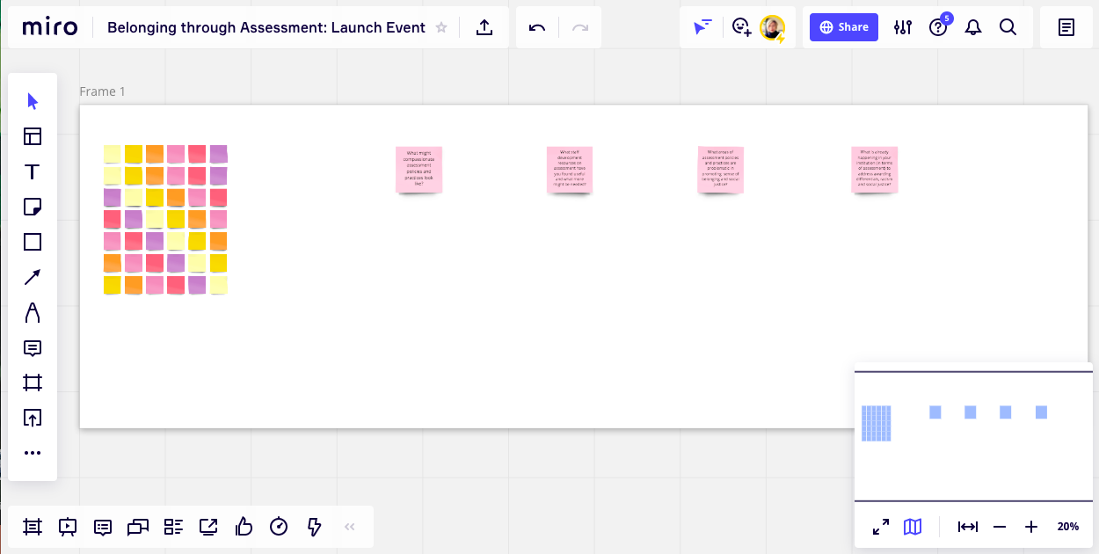
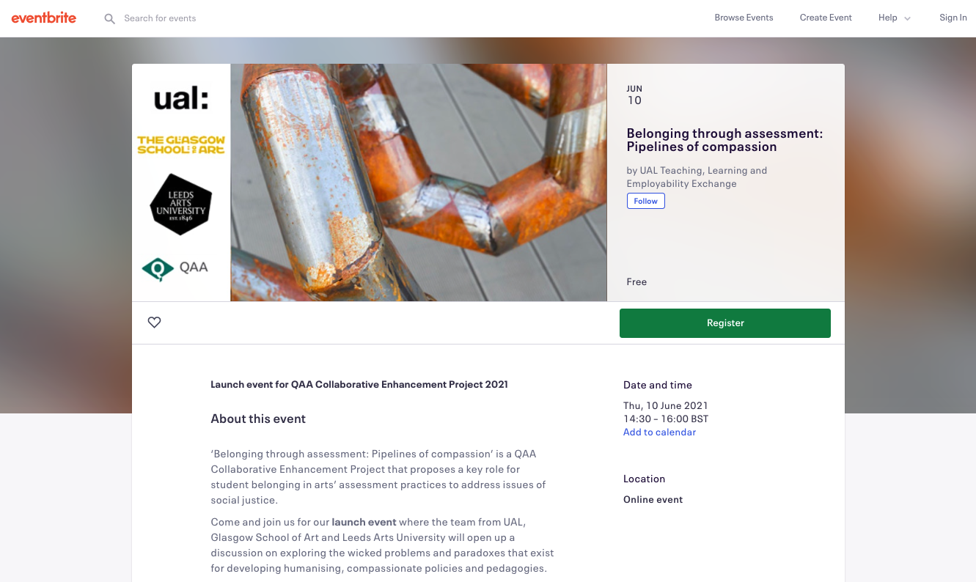
Today
Notes:
Intro to the session – Come and join us for our launch event where the team from UAL, Glasgow School of Art and Leeds Arts University will open up a discussion on exploring the wicked problems and paradoxes that exist for developing humanising, relational practices within managerialist culture.
https://miro.com/app/board/o9J_l_pfCjM=/

Slide 4
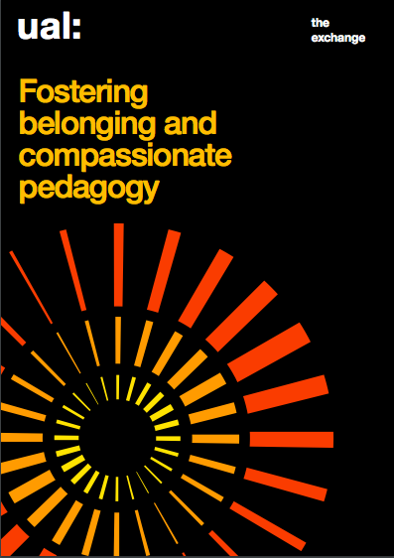
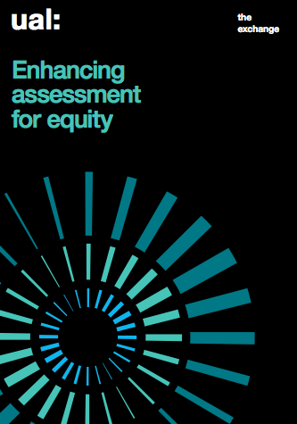
https://www.arts.ac.uk/about-ual/teaching-and-learning-exchange/resources/aem-and-attainment-resources
Notes:
At UaL I co-lead, with my colleague, Liz Bunting, the Fostering Belonging & Compassionate Pedagogy strand of enhancement work. (launched August 2020) it is one of three strands of staff development which brings course teams together to collaboratively problem-solve ways to address ethnicity awarding differentials between home white and home students of colour. The aim is to support course teams in developing teaching and learning strategies and compassionate pedagogies that nurture student belonging within their creative disciplinary context. We have designing this to create spaces for staff to interrogate their teaching interactions (both staff-to-student and student-to-student) in relation to bias, racism, oppression and silencing (NUS UUK, 2019).
This came at a critical moment in Higher Education, as the UK entered the first COVID-19 lockdown and the Black Lives Matter Movement globally amplified calls for racial justice in the wake of George Floyd’s murder. Our work aims to support academic staff to respond to these shifting contexts. Belonging will always matter, but at a time when people are starved of human connection it may have heightened importance (Strayhorn, 2020).

Slide 5
Belonging
‘...a feeling or sensation of connectedness, and the experience of mattering or feeling cared about, accepted, respected, valued by, and important...’ (Terrel Strayhorn, 2012, p. 4)
Compassion
‘...noticing of distress and/or disadvantage to self or others, and a commitment to take action to reduce it’ (Paul Gilbert, 2005).
Notes:
We understand the phenomena of belonging as an affective and transitory concept that can be lost and found on a students journey. We define it as ‘students’ feelings of being valued, respected, supported, included, and that they matter by teachers and peers, so that they feel part of the university learning community’ (Hill et al., 2020c) and acknowledge sector research that demonstrates the significance of it – as a psycho-social identity factor – to the inequitable experiences of global majority students (Mountford-Zimdars et al., 2015).
As belonging is affective, it is unstable; continually being contested and negotiated. During moments of vulnerability and change it takes on heightened importance and is at greater risk. As educators, we have the agency to influence this and can signal to students that they matter.
We’ve been considering how it can be fostered through our teaching practice, looking at compassionate pedagogy as a key approach. Compassionate pedagogy encourages educators to foster belonging by creating conditions that acknowledge structural oppression and reduce their impact on our students. We take Paul Gilbert’s (2005) definition of compassion as the ‘noticing of distress and/or disadvantage to self or others, and a commitment to take action to reduce it’. Page number Compassionate pedagogy concerns judgement and that focuses on transformation.

Slide 6
Assessment
‘If assessment shapes how and what students learn, as the literature suggests, and if we are committed to social justice within and through higher education, then surely assessment is key to the achievement of that social justice’ (Jan McArthur, 2021, p.6)
6
Notes:
It is clear we need to understand belonging through an intersectional lens which includes a wide range of under-represented groups' experiences and the disaggregation of data. Belonging has been significantly disrupted by COVID, with assessment policies and practices have moved into asynchronous and synchronous digital spaces and we’ve also seen how the instituions have responded through temporary no detriment policies. Evidence regarding issues of attainment and equity before COVID demonstrated a prevalence of ‘unbelonging’. COVID has exacerbated this and demonstrated the significance of compassion in our institutional policies.
This has brought the role of belonging in arts’ assessments practices into the social justice spotlight. We’ve been really influenced by Jan’s work and her as she quotes -
Assessment is relational, yet there is little dialogue/activity/work about how assessment can be approached to develop student belonging through meaningful compassionate interactions and practices and this is where we are interested in situating our work. At each stage of assessment, how our students experience feelings of belonging is critical to their involvement with their learning processes and their identification as successful HE learners.
1. Clearer understanding of the importance of belonging and compassion in assessment policies and practices, which have normative assumptions regarding what counts as valued interactions and contributions.
2. Discussion of the role assessment policies and practices play as pipelines in re-inscribing social inequalities of access to the teaching profession.
3. Propose new quality indicators of assessment surrounding belonging, compassion and equity, in critique of traditional metrics (e.g. NSS).

Slide 7
Project Aims:
1. Identify areas of enhancement in assessment policies and practices to promote student sense of belonging and tackle issues of social justice. 2. Link this relational work with attainment gap/awarding differentials agendas in the creative arts. 3. Develop collaborative, dialogic, polyvocal and affective resources for staff development across the HE sector.
Notes:
Our conversations around structure and agency have prompted us to think further about how we conceive of compassion and belonging within the whole institution. And we have been increasingly interested in how compassion can inform policy design, implementation and enactment – in particular, those related to assessment.
Our project began just under 2 weeks ago and we are building the project to work with staff and students across our creative arts institutions to...

Slide 8
Outputs: Blog
https://belongingthroughassessment.myblog.arts.ac.uk/
Notes:
Document the project and share research, events and learnings

Slide 9
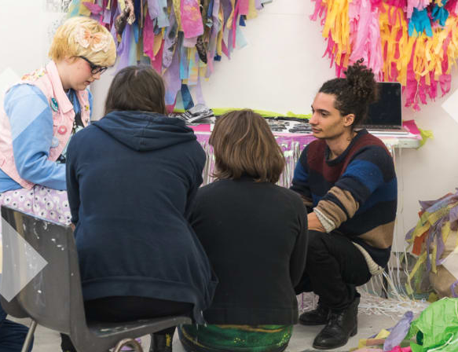
Outputs: Symposium 21st October
Notes:
Collaborative event that will form part of our research

Slide 10
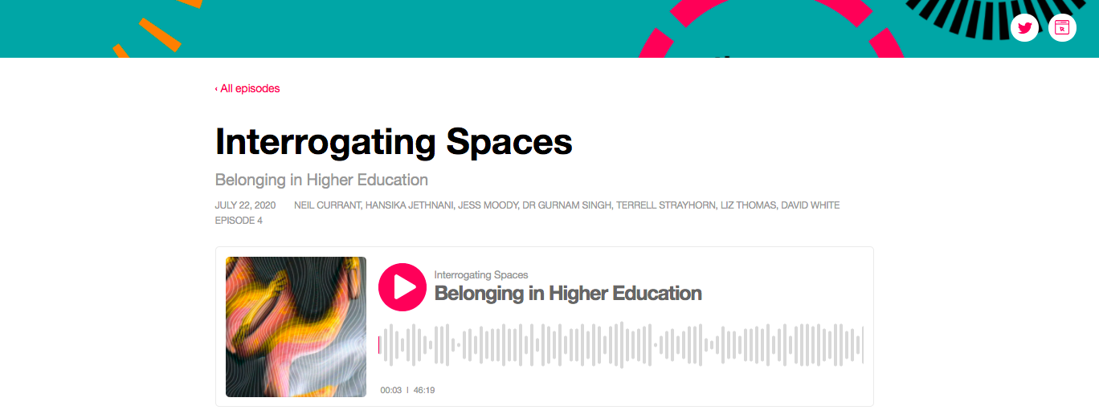
Outputs: Digital Resource
https://interrogatingspaces.buzzsprout.com/683798/4671476-belonging-in-higher-education
Notes:
We also constructed themes on expectation of staff development that builds on the Chsiropher Deneen* and David Boud's findings on epistemic, procedural and pragmatic resistance as our participants highlighted different needs with some wanting a more practical approach and others a more theoretical exploration of the rationale; this reveals a tension in participants between those looking for the ‘how do I do this? to’ and those questions 'why am I doing this?’
We really wanted to build on the importance of 'listening', both as an arts-based method and also a place for affective transformation as Carl Rogers states: it can be a most force for change. As the pandemic progressed we also identified the additional benefit of the podcast was that we could move away from the screen.
The podcasts provide a polyvocal dialogue, which continues beyond the podcast itself. Grounded in Paulo Freire’s critical pedagogy, they explore the dialogic relationships between teaching and learning in constructing knowledge through partnership to help staff find their own path / personal meaning.

Slide 11
References
Freire, P. (1970) Pedagogy of the Oppressed, New York: Seabury
Gilbert, P. (2005) ‘Compassion and cruelty: A biopsychosocial approach’. In Gilbert, P. (Ed.), Compassion: Conceptualisations, research and use in psychotherapy. New York: Routledge.
McArthur, J. (2021). Rethinking student involvement in assessment, Centre for Global Higher Education working paper series 58, https://www.researchcghe.org/perch/resources/working-paper-58final.pdf (Accessed 12/4/21)
Mountford-Zimdars, A., Sabri, D., Moore, J., Sanders, J., Jones, S. and Higham, L. (2015) Causes of differences in student outcomes. Report to HEFCE by King’s College London, ARC Network and The University of Manchester, available at: https://dera.ioe.ac.uk/23653/1/HEFCE2015_diffout.pdf
Strayhorn, T. L. (2019) College Students’ Sense of Belonging: A Key to Educational Success for All Students. 2nd Edn. Oxon: Routledge.
Strayhorn, T. (2020) ‘Belonging in online learning environments’, in Bunting, L., Hill, V. & Riggs, G. Interrogating Spaces [Podcast], available at: https://interrogatingspaces.buzzsprout.com/683798/4795271-belonging-in-online-learning-environments (Accessed 15/1/2021).
Thomas, L. (2012) Building student engagement and belonging in Higher Education at a time of change in Higher Education. London: Paul Hamlyn Foundation.

